Slide 1
CSCI2100D Lab 3
Xinyu Du
Department of Systems Engineering and Engineering Management
Chinese University of Hong Kong

Slide 2
Outline
Preorder Calculation
Min Binary Heap
Lower Bound
Map With AVL Tree(Bonus)
Overview of all problems

Slide 3
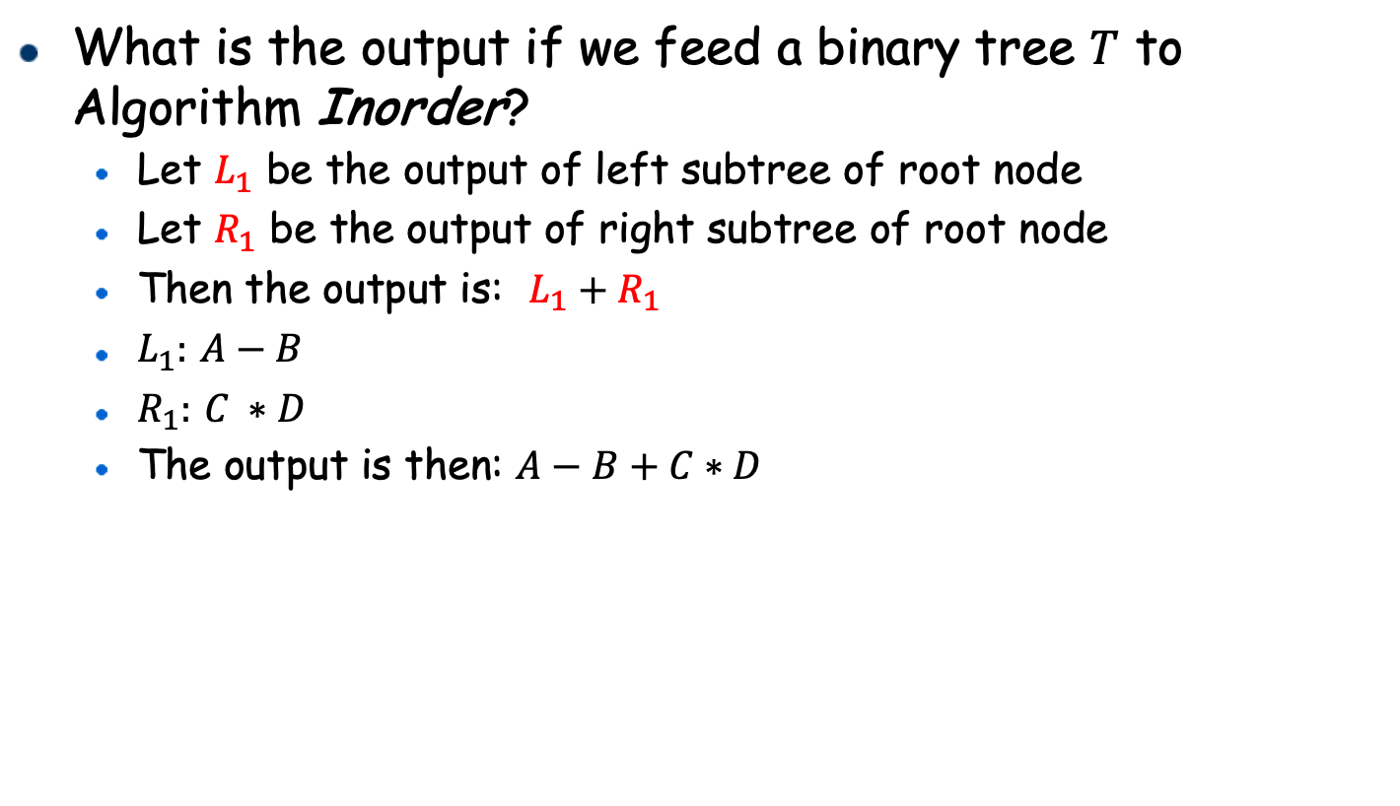
Inorder traversal
What is the output if we feed a binary tree $T$ to Algorithm Inorder?
Let $L_{1}$ be the output of left subtree of root node
Let $R_{1}$ be the output of right subtree of root node
Then the output is: $L_{1}+R_{1}$
$L_{1}:$ $A−B$
$R_{1}:$ $C ∗D$
The output is then: $A−B+C∗D$
+
-
*
A
B
C
D
Algorithm: Inorder(btree)
1
2
3
4
if !isEmpty(btree)
Inorder(Lchild(btree))
print Data(btree)
Inorder(Rchild(btree))

Slide 4
Postorder traversal & Preorder traversal
Postorder traversal:
Postorder traverse the left-subtree;
Postorder traverse the right-subtree;
Finally, visit the root node.
Preorder traversal:
First visit the root node;
Preorder traverse the left-subtree;
Preorder traverse the right-subtree.
Algorithm: Postorder(btree)
1
2
3
4
if !isEmpty(btree)
Postorder(Lchild(btree))
Postorder(Rchild(btree))
print Data(btree)
Algorithm: Preorder(btree)
1
2
3
4
if !isEmpty(btree)
print Data(btree)
Preorder(Lchild(btree))
Preorder(Rchild(btree))

Slide 5
Preorder Calculation
Use in-order and post-order traversal sequences to build a binary tree.
1. Postorder could locate the root node of a tree.
2. Find this root node in post-order sequence, and separate the tree into two parts: left and right.
3. For the left and right part, find the root point from the Post-order sequence, respectively.
4. Repeat the process and construct the tree.
5. Output the pre-order traversal sequence from the tree.

Slide 6
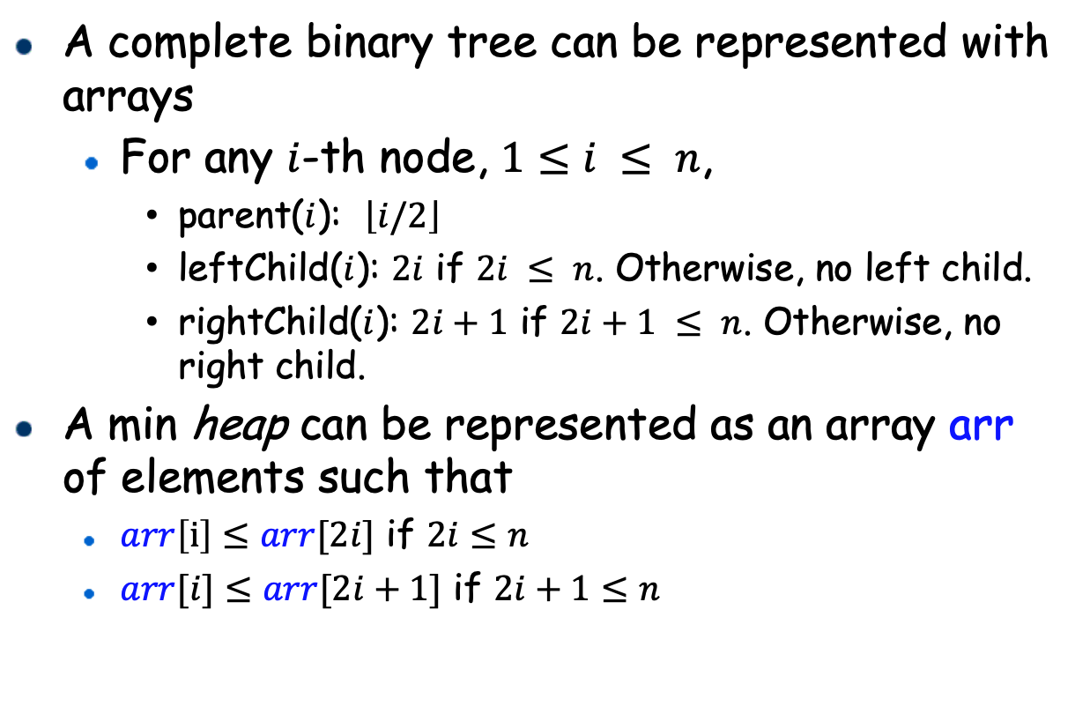
Min Binary Heap
A complete binary tree can be represented with arrays
For any $i$-th node, $1≤i ≤ n$,
parent($i$): $\left\lfloor i/2\right\rfloor$
leftChild($i$): $2i$ if $2i ≤ n$. Otherwise, no left child.
rightChild($i$): $2i+1$ if $2i+1 ≤ n$. Otherwise, no right child.
A min heap can be represented as an array arr of elements such that
$arr\left[i\right]≤arr[2i]$ if $2i≤n$
$arr[i]≤arr[2i+1]$ if $2i+1≤n$
[1]
[2]
[3]
[4]
[5]
[6]
[7]
[8]
[9]
3 5 8 12 9 10 58 33 22
3
1
2
5
8
3
4
12
9
5
6
10
58
7
8
33
22
9

Slide 7
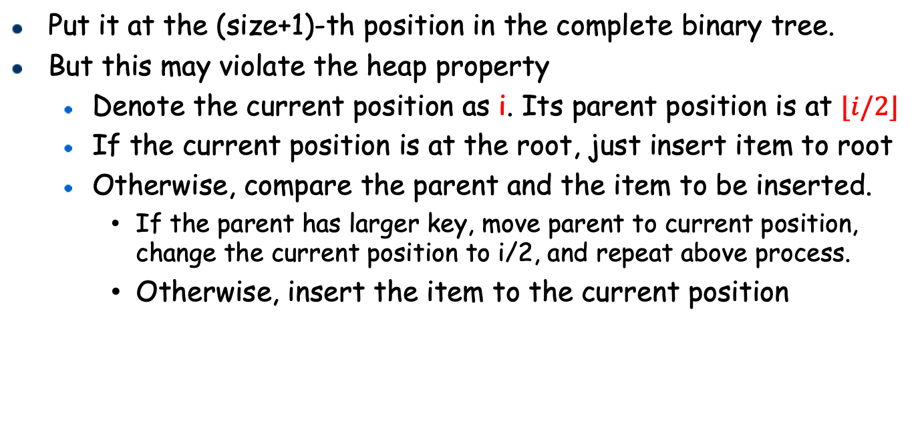
Heap Insertion: Implementation
Put it at the (size+1)-th position in the complete binary tree.
But this may violate the heap property
Denote the current position as i. Its parent position is at $⌊i/2⌋$
If the current position is at the root, just insert item to root
Otherwise, compare the parent and the item to be inserted.
If the parent has larger key, move parent to current position, change the current position to i/2, and repeat above process.
Otherwise, insert the item to the current position

Slide 8
Heap Deletion
Return and delete the smallest element,
Which one to delete?
According to the min-heap property, the smallest element is at the root.
Which one to fill at the root?
The tree must still be a complete binary tree: Use the last one to fill the root position
This obviously violates the heap property: how to resolve?
Repeatedly swap with the child with smaller key if heap property is violated.
[1]
2
[1]
Replace the last node as the root
How to resolve?
Delete the root
[1]
15
[2]
14
[3]
20
[2]
14
[3]
20
[4]
[2]
14
[3]
2
15
[4]
15

Slide 9
Heap Deletion
[1]
2
delete h[1]: the smallest
[1]
[1]
place h[size] at the root
15
[2]
10
[3]
20
[2]
10
[3]
20
[2]
10
[3]
20
[4]
14
[5]
15
[4]
14
[5]
15
[4]
14
initial heap
Compare with two children, swap with the smaller one
[1]
10
Compare with two children, swap with the smaller one
[1]
10
[2]
15
[3]
20
[2]
[3]
14
20
[4]
14
[4]
15

Slide 10
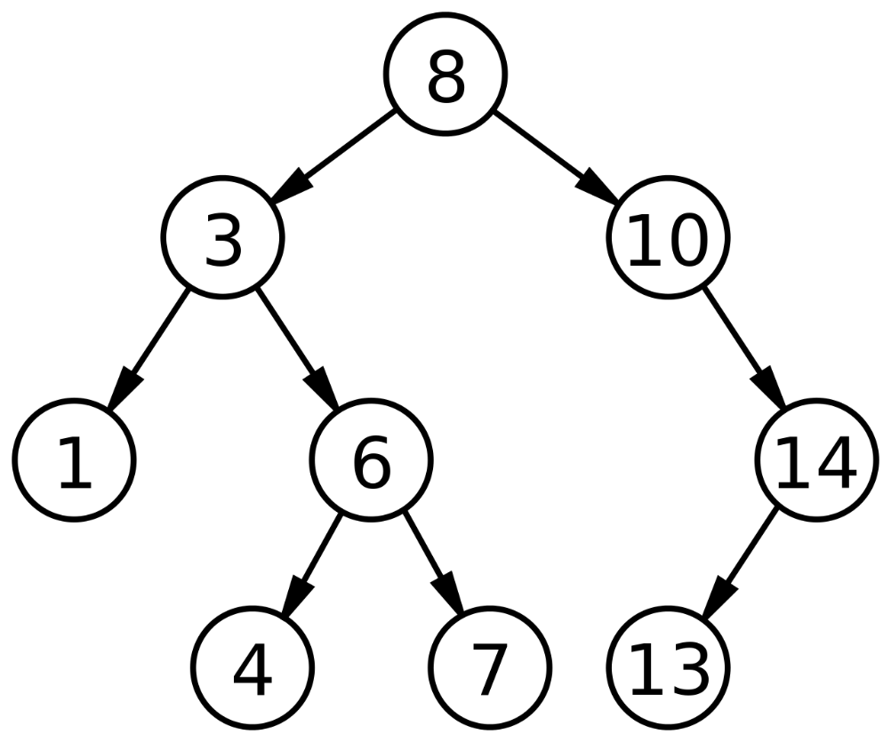
Lower Bound in BST
A binary search tree is a binary tree that satisfies the following properties:
Every node has a unique key.
For each internal node x:
All nodes in a nonempty left subtree of x must have keys smaller than the key of x.
All nodes in a nonempty right subtree of x must have keys larger than the key of x.
If you want to report lower bound of 5 in this BST.
Since the value of the current element(root) is 8, which is larger than 5, just go to the left son of it, which is 3. Since the value of 3 is smaller than 5, we go to the right son of it, which is 6. We continue to check 6’s left son, which is 4. But node 4 does not have right child. Finally, we report 6.

Slide 11
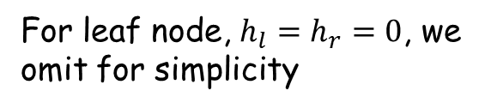
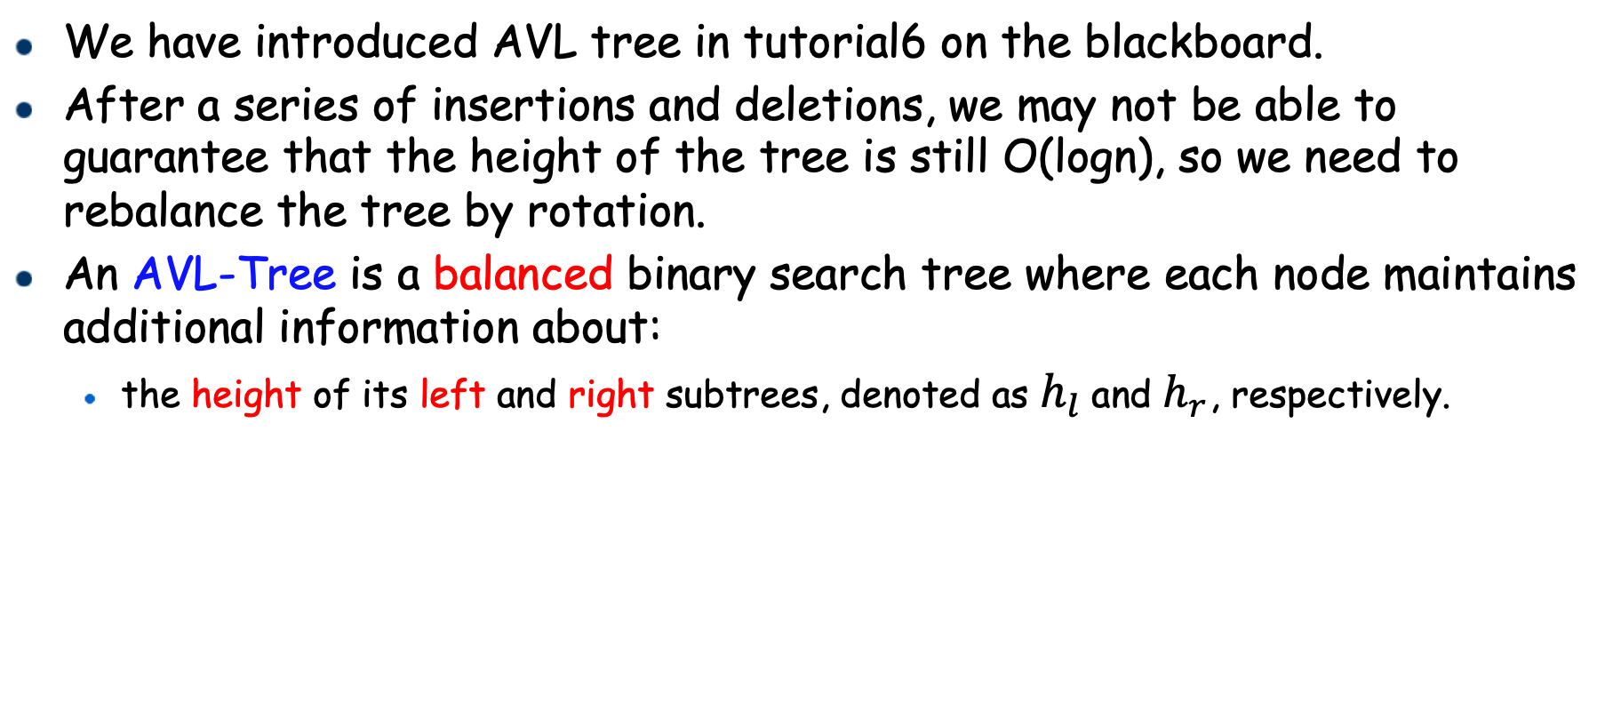




AVL Tree
We have introduced AVL tree in tutorial6 on the blackboard.
After a series of insertions and deletions, we may not be able to guarantee that the height of the tree is still O(logn), so we need to rebalance the tree by rotation.
An AVL-Tree is a balanced binary search tree where each node maintains additional information about:
the height of its left and right subtrees, denoted as $h_{l}$ and $h_{r}$, respectively.
By storing the subtree heights, a non-leaf node knows whether it has become imbalanced.
3
$$h_{l}:1$$
$$h_{r}:2$$
2
7
For leaf node, $h_{l}=h_{r}=0$, we omit for simplicity
$$h_{l}:1$$
$$h_{r}:1$$
5
9
An example of an AVL-Tree

Slide 12
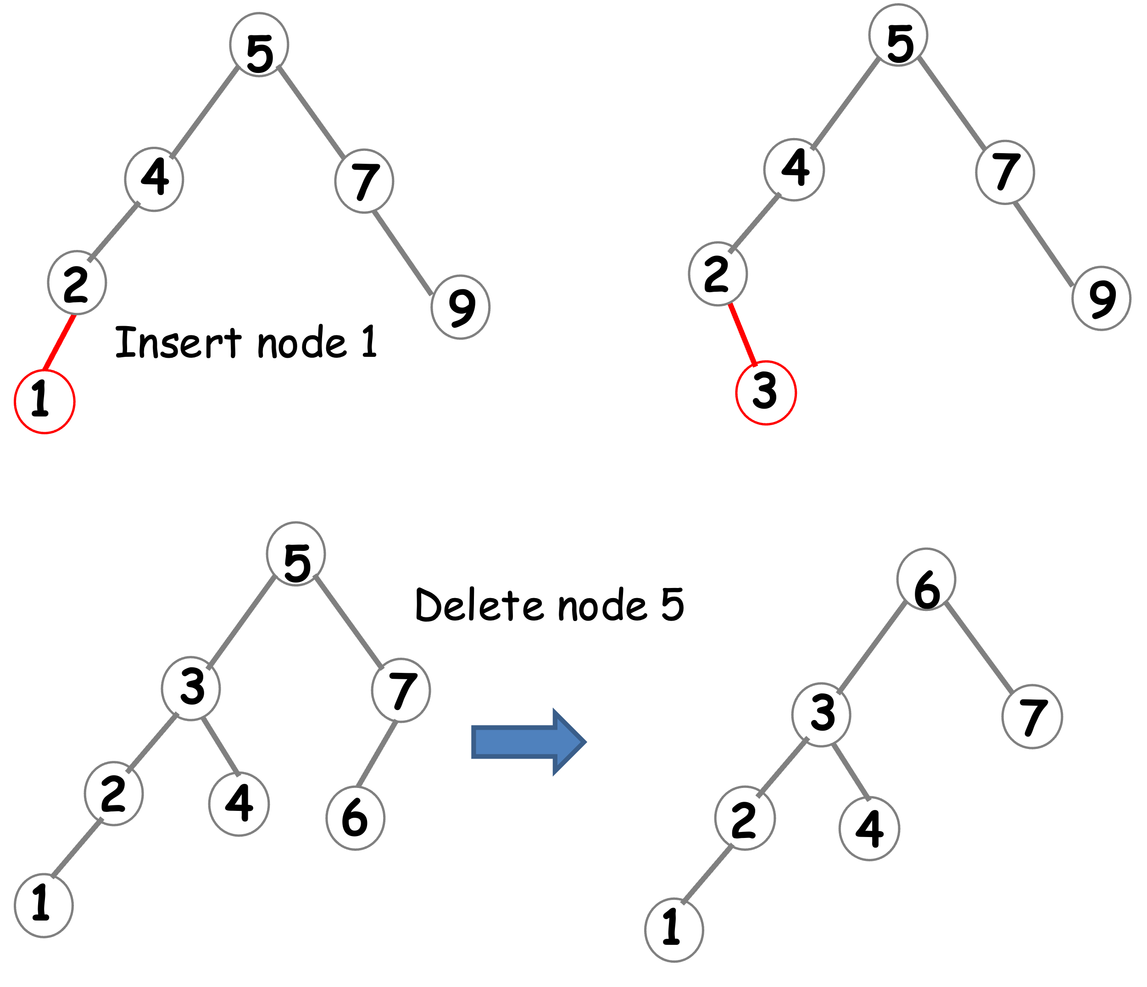
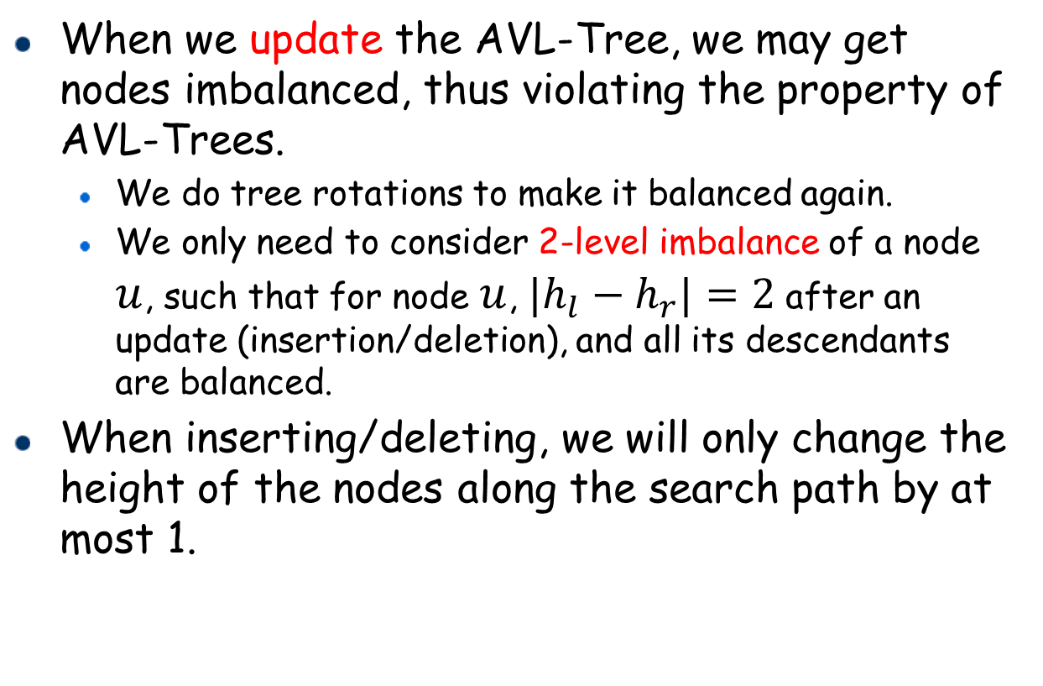
AVL Tree
When we update the AVL-Tree, we may get nodes imbalanced, thus violating the property of AVL-Trees.
We do tree rotations to make it balanced again.
We only need to consider 2-level imbalance of a node $u$, such that for node $u$, ${|h}_{l}−h_{r}|=2$ after an update (insertion/deletion), and all its descendants are balanced.
When inserting/deleting, we will only change the height of the nodes along the search path by at most 1.
Insert node 3

Slide 13
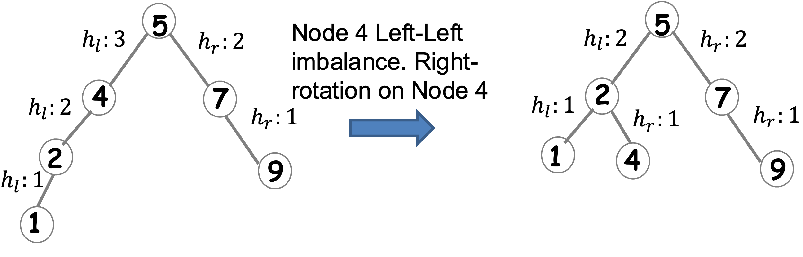



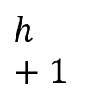
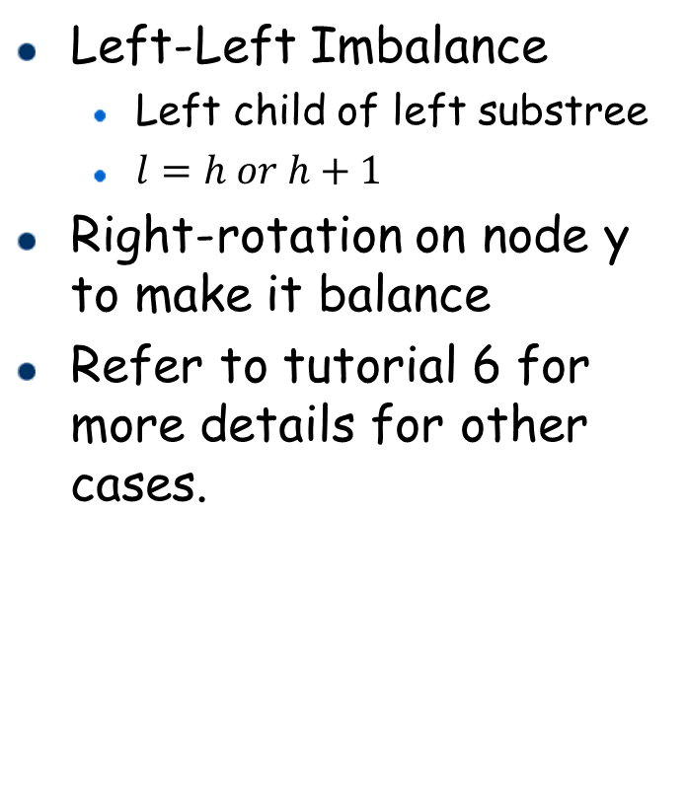




AVL Tree
Left-Left Imbalance
Left child of left substree
$l=h or h+1$
Right-rotation on node y to make it balance
Refer to tutorial 6 for more details for other cases.
Right-Rotation on y
$h+2$
y
x
$h$
$h+1$
$x+1$
x
y
$h+1$
$l$
$h$
$l$
>y
<y
<x
<y
>y
<x
>x
>x
Algorithm: llRotation(y)
1
2
3
4
5
6
7
Node x = y.left
Node tmp = x.right
x.Right = y
y.Left = tmp
y.Height = max(y.left.height, y.right.height)+1
x.Height = max(x.left.height, x.right.height)+1

Slide 14
Declaration
3 Problems (Required) + 1 Problem (Bonus)
Please add this declaration on the top of all your codes submitted to the OJ.
/*
I, <Your Full Name>, am submitting the assignment for
an individual project.
I declare that the assignment here submitted is original except for source material explicitly acknowledged, the piece of work, or a part of the piece of work has not been submitted for more than one purpose (i.e., to satisfy the requirements in two different courses) without declaration. I also acknowledge that I am aware of University policy and regulations on honesty in academic work, and of the disciplinary guidelines and procedures applicable to breaches of such policy and regulations, as contained in the University website http://www.cuhk.edu.hk/policy/academichonesty/.
It is also understood that assignments without a properly signed declaration by the student concerned will not be graded by the teacher(s).
*/

Slide 15
Problem 1
Preorder Calculation
Use the provided code template, complete the missing part.
Preorder Calculation
Description:
Use in-order and post-order traversal sequences to build a binary tree.
Input:
The first line contains one integer N;
The second line contains N integers, which is the in-order traversal sequence;
The third line contains N integers, which is the post-order traversal sequence;
Output:
The pre-order traversal sequence
Sample Input 1: Sample Output 1:
10 4 2 1 3 7 6 5 9 8
1 2 3 4 5 6 7 8 9 10
1 3 2 5 6 8 10 9 7 4

Slide 16
Problem 2
Min Binary Heap
Use the provided code template, complete the missing part.
Min Binary Heap
Description:
Implement the min binary heap.
Input:
The first line contains two integers which are capacity and N; The next N lines, each of which contains an operation: push x (an Integer) or top or pop
Output:
Each line is the warning or result of Top
Sample Input 1: Sample Output 1:
3 3
8 2
push 4 3
push 3
top
push 2
push 1
top
pop
top

Slide 17
Problem 3
Lower Bound
Use the provided code template, complete the missing part.
Lower Bound
Description:
Calculate the lower bound of a number in the binary search tree. The lower bound of a number A is the first number in the binary search tree which is not less than A. It must cost O(log N) time to calculate the lower bound of a number.
Input:
The first line contains one integer: N;
The second line contains N integers, which are used to build the binary search tree;
The third line contains one integer: N;
The fourth line contains N integers;
Output:
For each integer in the fourth line, output its lower bound in the binary search tree.
Sample Input 1: Sample Output 1:
9 4
4 2 1 3 7 6 5 9 10 9
4 -999999
4 8 11 0 1

Slide 18
Problem 4 (Bonus)
Map With AVL Tree
Use the provided code template, complete the missing part.
Map With AVL Tree(Bonus)
Description:
Implement the map ADT with the AVL tree. The map ADT has four operations:
Put(key, value): insert a key-value pair into the map. If it already has the key, then update the value.
Get(key): given a key, report its value. If it does not have this key, report INF.
Erase(key): delete this key from the map.
Size(): report the number of elements inside the map. Additionally, keys are sorted from smallest to largest, allowing for efficient traversal of all key-value pairs in ascending order based on the key. The traversal must be achieved in O(N) total time.
Input:
The first line contains one integer: N; The next N lines, each of which contains one of these operations: 1. put key value (two Integers) or 2. get key 3. erase key 4. size 5. print
Output:
Each line is the result of get or size or print.

Slide 19
Problem 4 (Bonus)
Map With AVL Tree
Sample Input 1:
20
put 7 7
put 9 9
put 11 11
put 5 5
put 4 4
put 6 6
put 8 8
put 12 12
put 15 15
put 10 10
get 4
put 4 1
get 4
erase 4
get 4
erase 6
erase 15
erase 12
size
print
Sample Output 1:
4
1
-999999
6
Preorder: <9,9> <7,7> <5,5> <8,8> <11,11> <10,10>
Inorder: <5,5> <7,7> <8,8> <9,9> <10,10> <11,11>
Postorder: <5,5> <8,8> <7,7> <10,10> <11,11> <9,9>

